Slide 1
Deep Learning
Dr. MERT NAKIP
Reference books and lecture notes:
CS229 Lecture Notes, Andrew Ng and Tengyu Ma
Lecture Notes on ANN (private), Cüneyt Güzeliş
Neural Networks and Learning Machines, Simon Haykin

Slide 2
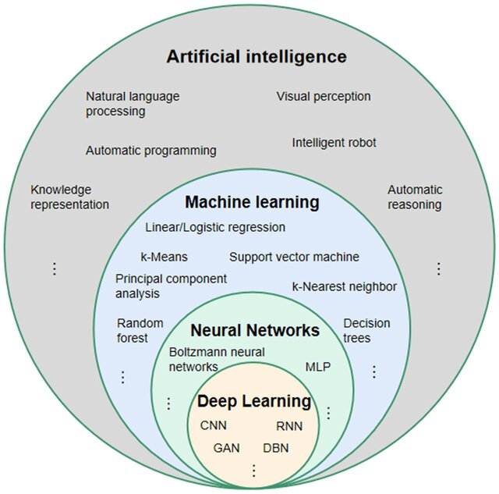
What is Deep Learning?
Li, S., Deng, Y.Q., Zhu, Z.L., Hua, H.L., & Tao, Z.Z. (2021). A comprehensive review on radiomics and deep learning for nasopharyngeal carcinoma imaging. Diagnostics,11(9), 1523.

Slide 3
Supervised Learning
Labeled datasets to train algorithms
Sample Set / Training Set
Learning Algorithm
Deep Learning Model
Input(s)
Output(s)

Slide 4
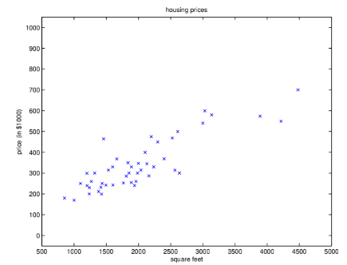
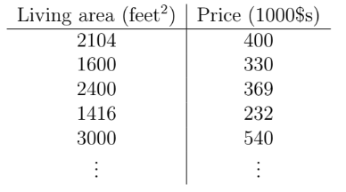
Supervised Learning
a dataset giving the living areas and prices of 47
houses from Portland, Oregon:

Slide 5


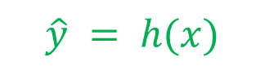
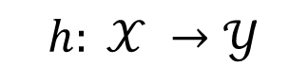

Supervised Learning
Sample Set / Training Set
$$\{X, Y\}$$
Learning Algorithm
Deep Learning Model
Input(s)
Output(s)
$$x$$
$$\hat{y}$$
$$h: 𝒳 →𝒴$$
$$\hat{y} = h(x)$$

Slide 6
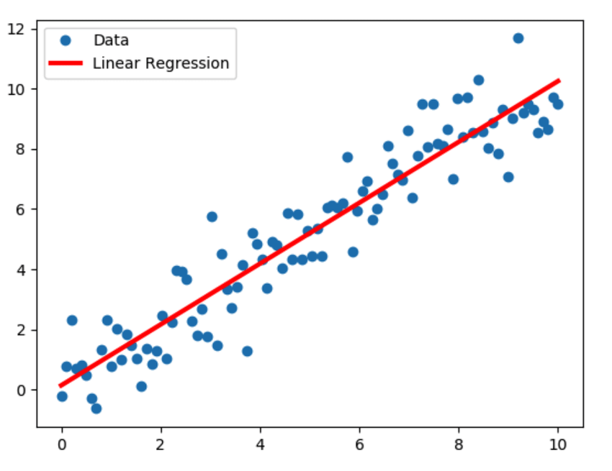
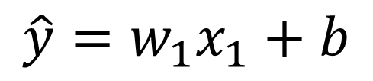
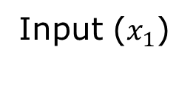
Linear Regression (LR)
$$\hat{y}=w_{1}x_{1}+b$$
Output
Input ($x_{1}$)
http://sphweb.bumc.bu.edu/otlt/MPH-Modules/BS/R/R5_Correlation-Regression/R5_Correlation-Regression4.html
https://www.researchgate.net/figure/Linear-Regression-model-sample-illustration_fig3_333457161

Slide 7
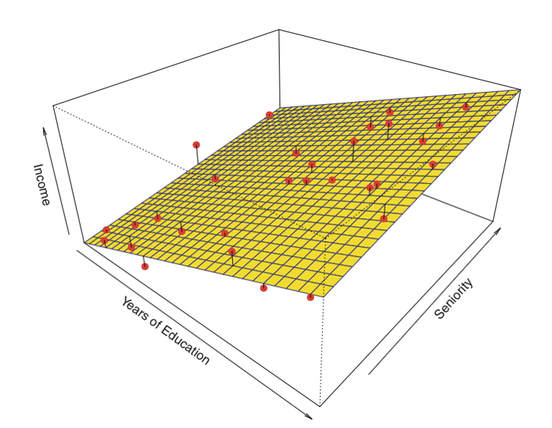
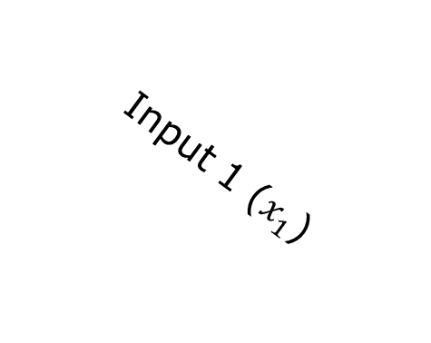
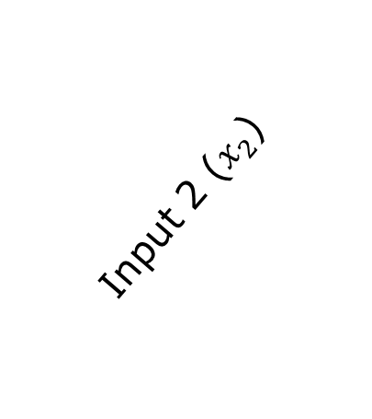
Linear Regression (LR)
$$\hat{y}=w_{1}x_{1}+w_{2}x_{2}+b$$
Output
Input 2 ($x_{2}$)
Input 1 ($x_{1}$)
http://sphweb.bumc.bu.edu/otlt/MPH-Modules/BS/R/R5_Correlation-Regression/R5_Correlation-Regression4.html
https://www.researchgate.net/figure/Linear-Regression-model-sample-illustration_fig3_333457161

Slide 8
Linear Regression (LR)
Linear Assumption: LR does not support anything else. You may need to transform data to make the relationship linear.
Remove Noise: LR assumes that your input and output variables are not noisy.
Remove Collinearity. LR will over-fit your data when you have highly correlated input variables.
Gaussian Distributions. Linear regression will make more reliable predictions if your input and output variables have a Gaussian distribution.
Rescale Inputs: LR will often make more reliable predictions if you rescale input variables using standardization or normalization.
Output
Input 2 ($x_{2}$)
Input 1 ($x_{1}$)
$$\hat{y}=w_{1}x_{1}+w_{2}x_{2}+b$$
http://sphweb.bumc.bu.edu/otlt/MPH-Modules/BS/R/R5_Correlation-Regression/R5_Correlation-Regression4.html
https://www.researchgate.net/figure/Linear-Regression-model-sample-illustration_fig3_333457161

Slide 9



Least-Squares Cost
$$J\left(w\right)= \frac{1}{2} \sum_{i=1}^{N}{{\left({\hat{y}}^{(i)}−y^{(i)}\right)}^{2}}$$
$$= \frac{1}{2} \sum_{i=1}^{N}{{\left({h(x}^{(i)})−y^{(i)}\right)}^{2}}$$
$$= \frac{1}{2} \sum_{i=1}^{N}{{\left({(w^{T} x}^{(i)})−y^{(i)}\right)}^{2}}$$

Slide 10
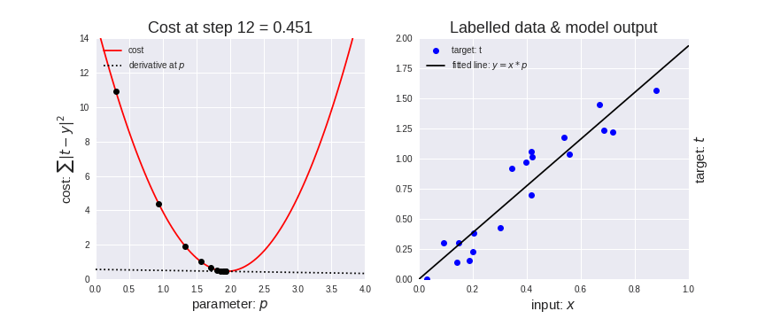
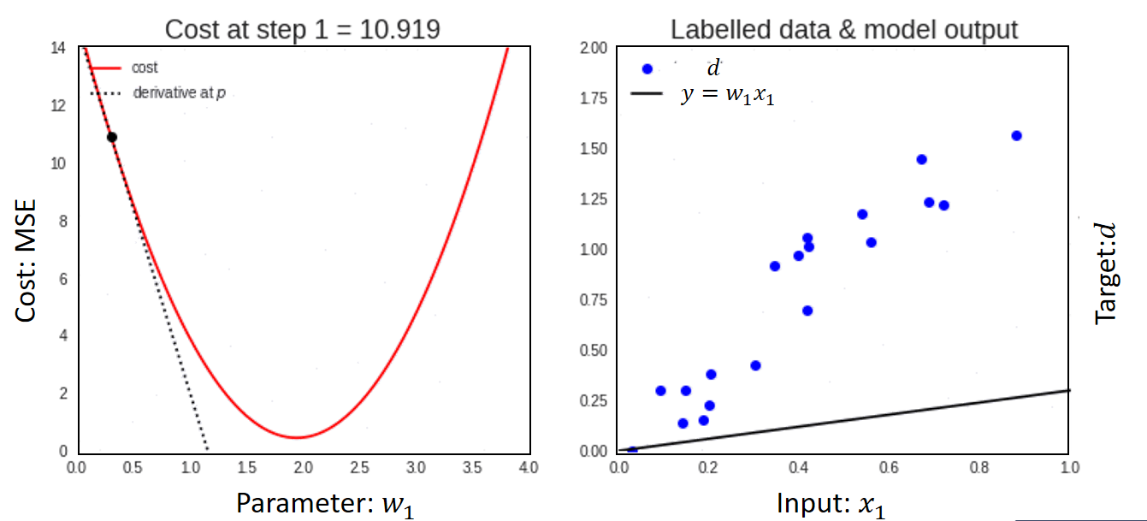

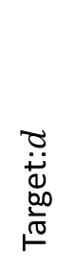
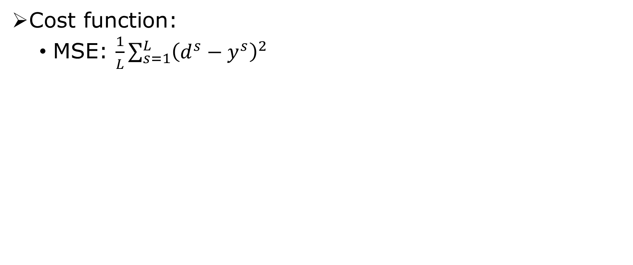
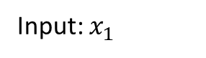
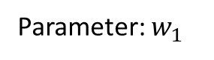
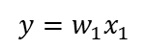
Training: Cost Function and Cost Minimization
Cost Minimization Algorithm :
Gradient Descent
Cost function:
MSE: $\frac{1}{L}\sum_{s=1}^{L}{{\left(d^{s}−y^{s}\right)}^{2}}$
$$d$$
$$y=w_{1}x_{1}$$
Cost: MSE
Target:$d$
Parameter: $w_{1}$
Input: $x_{1}$
https://forums.fast.ai/t/unofficial-lesson-8-classnotes/8184

Slide 11
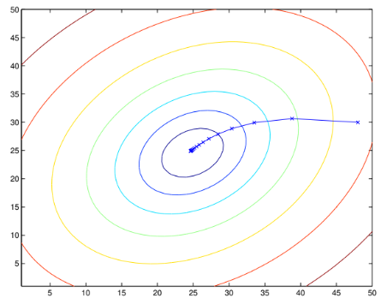
Training: Cost Function and Cost Minimization
https://forums.fast.ai/t/unofficial-lesson-8-classnotes/8184

Slide 12

Gradient Descent
$$w_{j}←w_{j} −η \frac{δ}{δw_{j}}J(w)$$

Slide 13


Gradient Descent
$$w_{j}←w_{j} −η \frac{δ}{δw_{j}}J(w)$$
Partial Derivative Term – Batch Learning:
$$\frac{δ}{δw_{j}}J\left(w\right)=\frac{δ}{δw_{j}}\frac{1}{2}\sum_{i=1}^{N}{{\left({\hat{y}}^{(i)}−y^{(i)}\right)}^{2}}$$

Slide 14

Gradient Descent
$$w_{j}←w_{j} −η \frac{δ}{δw_{j}}J(w)$$
Partial Derivative Term – Batch Learning:
$$\frac{δ}{δw_{j}}J\left(w\right)=\frac{δ}{δw_{j}}\frac{1}{2}\sum_{i=1}^{N}{{\left({\hat{y}}^{(i)}−y^{(i)}\right)}^{2}}$$
$$=\sum_{i=1}^{N}{\left(x_{j}^{(i)}\right)\left({\hat{y}}^{(i)}−y^{(i)}\right)}$$

Slide 15


Least Mean Squares (LMS) Rule
$$w_{j}←w_{j} −η \frac{δ}{δw_{j}}J(w)$$
$$w_{j}←w_{j} −η\sum_{i=1}^{N}{\left(x_{j}^{(i)}\right)\left({\hat{y}}^{(i)}−y^{(i)}\right)}$$

Slide 16
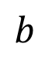
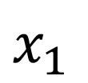
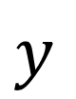
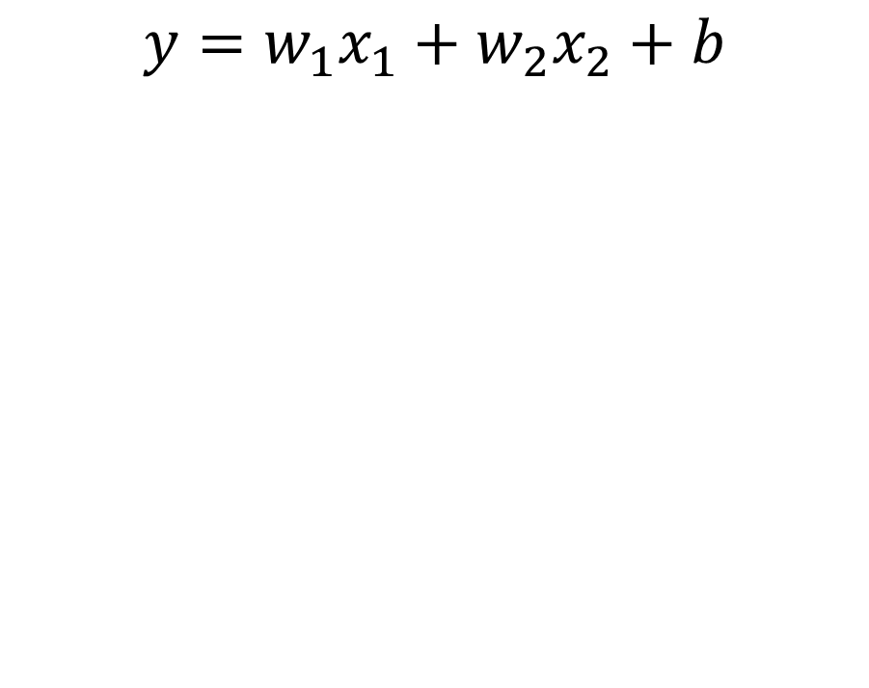
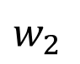
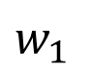
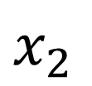

Adaptive Linear Neuron (Adaline)
Same with the Linear Regression
$1$
$$y=w_{1}x_{1}+w_{2}x_{2}+b$$
$b$
$x_{1}$
$w_{1}$
Σ
$y$
$w_{2}$
$x_{2}$

Slide 17
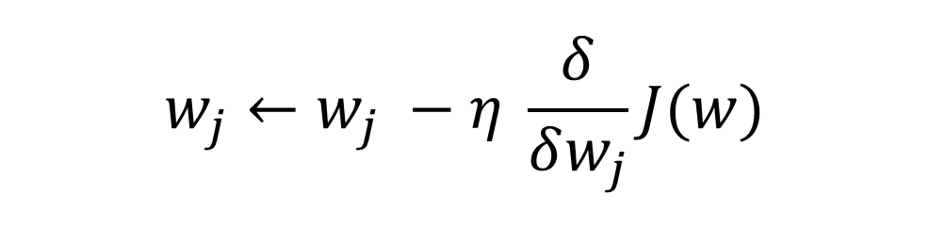
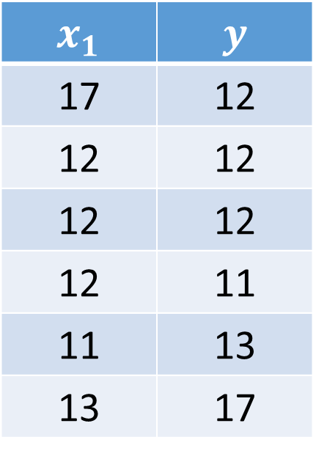
An example
$$x_{1}$$ | $$y$$
17 | 12
12 | 12
12 | 12
12 | 11
11 | 13
13 | 17
$$w_{j}←w_{j} −η \frac{δ}{δw_{j}}J(w)$$

Slide 18
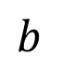
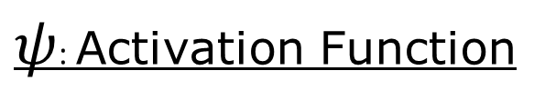
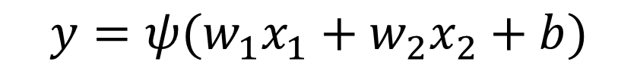
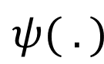

Nonlinear Neuron
$1$
$ψ$: Activation Function
$b$
$x_{1}$
$w_{1}$
Σ
$ψ( .)$
$y$
$w_{2}$
$x_{2}$
$$y=ψ(w_{1}x_{1}+w_{2}x_{2}+b)$$
The difference between Adaline and Perceptron is non-linear activation function.

Slide 19
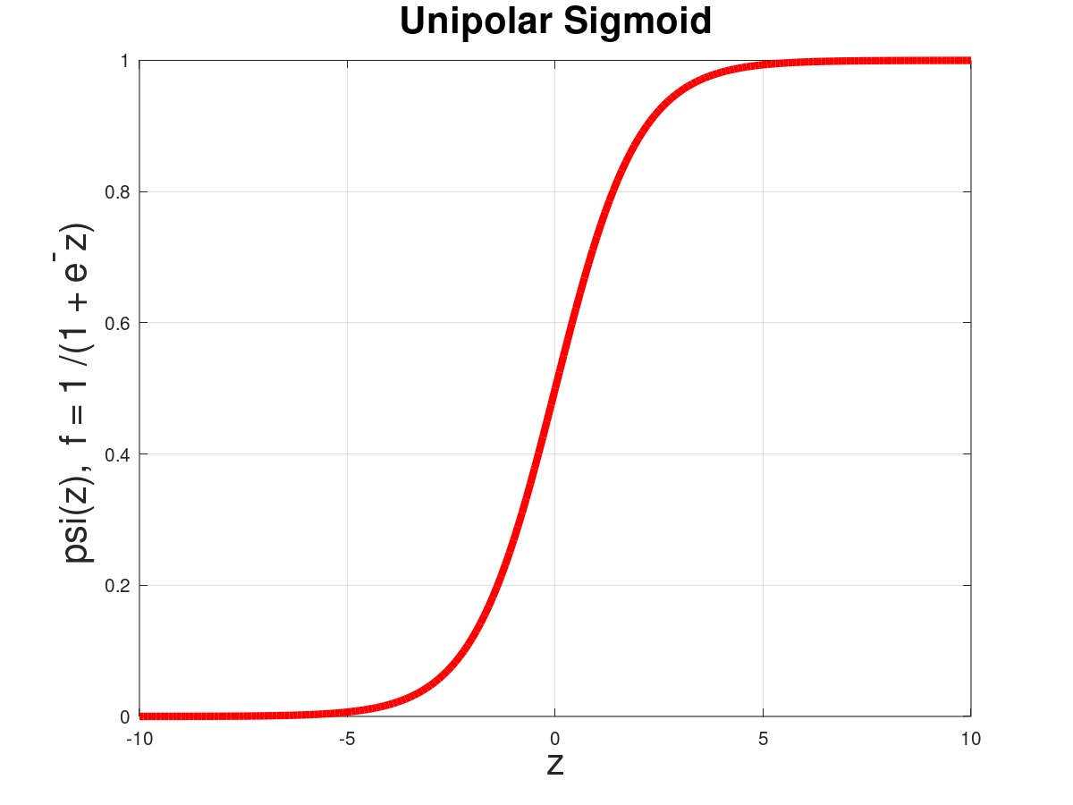
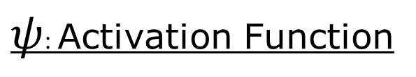
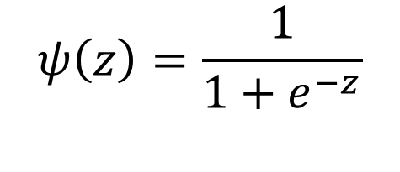


Nonlinear Neuron
$ψ$: Activation Function
$1$
$b$
$$ψ\left(z\right)=\frac{1}{1+e^{−z}}$$
$x_{1}$
$w_{1}$
Σ
$ψ( .)$
$y$
$w_{2}$
$x_{2}$
$$ψ(z)$$
$$y=ψ(w_{1}x_{1}+w_{2}x_{2}+b)$$
$$z$$
The difference between Adaline and Perceptron is non-linear activation function.

Slide 20
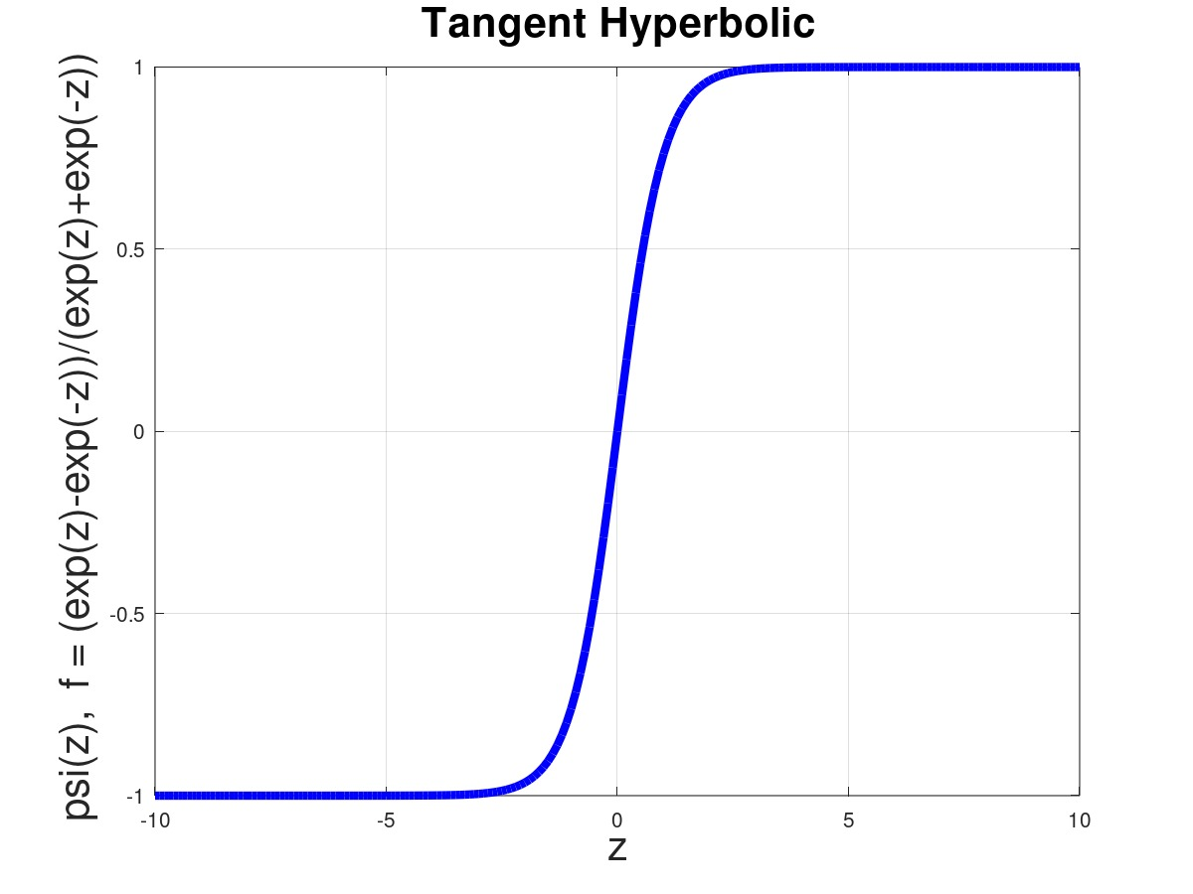
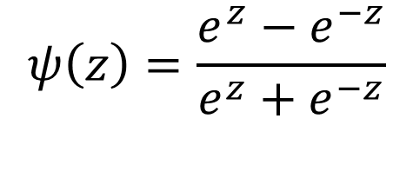
Nonlinear Neuron
$ψ$: Activation Function
$1$
$b$
$$ψ\left(z\right)=\frac{e^{z}−e^{−z}}{e^{z}+e^{−z}}$$
$x_{1}$
$w_{1}$
Σ
$ψ( .)$
$y$
$w_{2}$
$x_{2}$
$$ψ(z)$$
$$y=ψ(w_{1}x_{1}+w_{2}x_{2}+b)$$
$$z$$
The difference between Adaline and Perceptron is non-linear activation function.

Slide 21
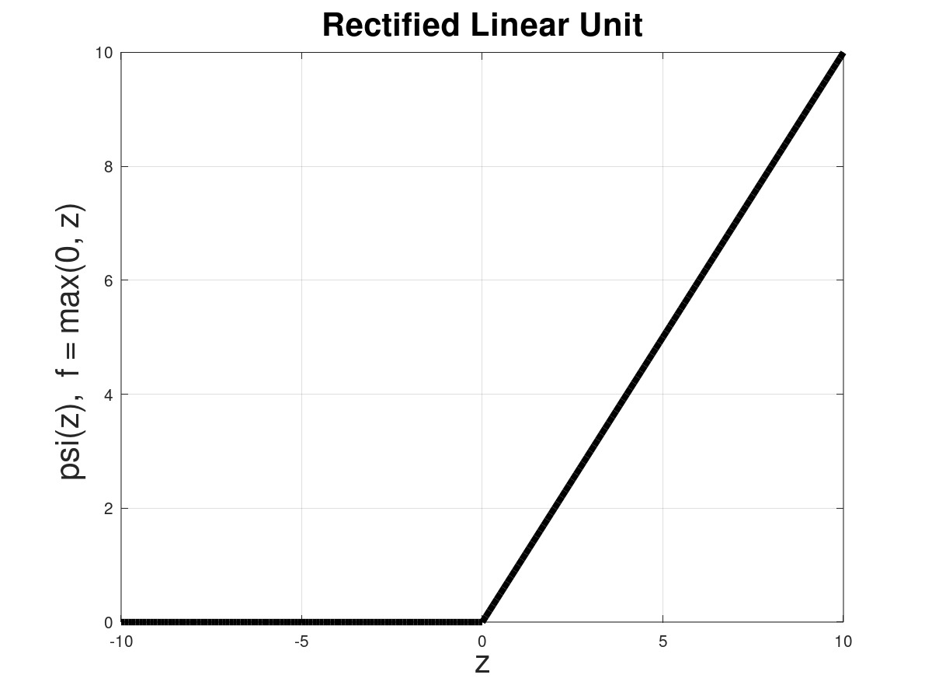
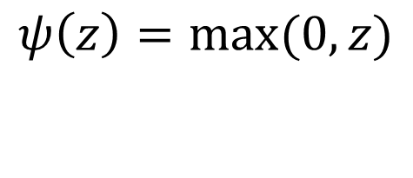
Nonlinear Neuron
$ψ$: Activation Function
$1$
$b$
$$ψ\left(z\right)=max⁡(0, z)$$
$x_{1}$
$w_{1}$
Σ
$ψ( .)$
$y$
$w_{2}$
$x_{2}$
$$ψ(z)$$
$$y=ψ(w_{1}x_{1}+w_{2}x_{2}+b)$$
$$z$$
The difference between Adaline and Perceptron is non-linear activation function.

Slide 22
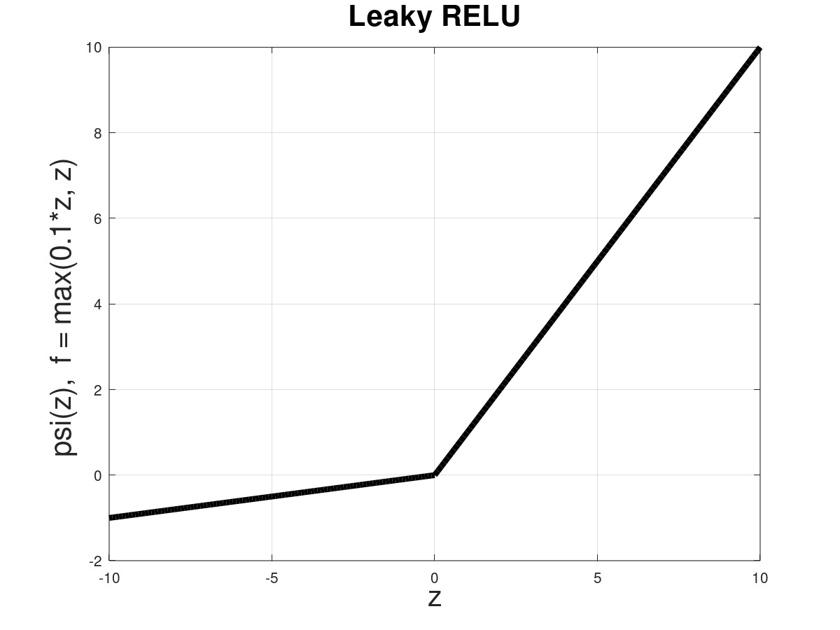
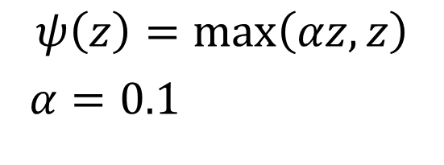
Nonlinear Neuron
$ψ$: Activation Function
$1$
$b$
$$ψ\left(z\right)=\max\left(αz, z\right)$$
$α=0.1$
$x_{1}$
$w_{1}$
Σ
$ψ( .)$
$y$
$w_{2}$
$x_{2}$
$$ψ(z)$$
$$y=ψ(w_{1}x_{1}+w_{2}x_{2}+b)$$
$$z$$
The difference between Adaline and Perceptron is non-linear activation function.

Slide 23



Mean Squared Error
$$L\left(w\right)= \frac{1}{N}\sum_{i=1}^{N}{{\left(y^{(i)}−{\hat{y}}^{(i)}\right)}^{2}}$$
$$\frac{δ}{δw_{j}}L\left(w\right)=\frac{δ}{δw_{j}}\frac{1}{N}\sum_{i=1}^{N}{{\left(y^{(i)}−{\hat{y}}^{(i)}\right)}^{2}}$$
$$=\frac{1}{N}\sum_{i=1}^{N}{\left(−x_{j}^{(i)}\right)\left(y^{(i)}−{\hat{y}}^{(i)}\right)}$$

Slide 24
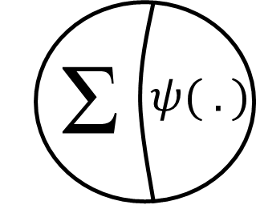
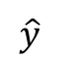
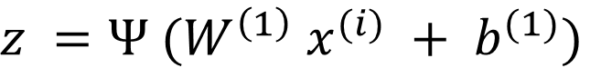
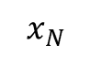
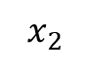
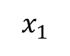
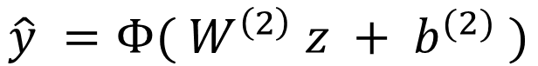
Shallow Neural Networks
$$x_{1}$$
$z =Ψ (W^{\left(1\right)} x^{(i)} + b^{(1)})$
$$\hat{y} =Φ( W^{\left(2\right)} z + b^{(2)} )$$
$$x_{2}$$
$$\hat{y}$$
$$x_{N}$$

Slide 25
Example of Discrete Activation

Slide 26
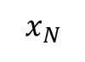
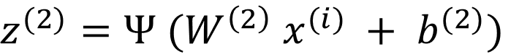





Multilayer Perceptron (MLP)
$$x_{1}$$
$z^{(2)}=Ψ (W^{\left(2\right)} x^{(i)} + b^{(2)})$
$$\hat{y} =Φ( W^{\left(3\right)} z + b^{(3)} )$$
$$x_{2}$$
$$\hat{y}$$
Works for both regression and classification
MLP is the Fully Connected layer of deep learning models
(e.g. CNN and LSTM)
$$x_{N}$$
$z^{(1)}=Ψ (W^{\left(1\right)} x^{(i)} + b^{(1)})$

Slide 27
Example of Discrete Activation

Slide 28

Feed Forward & Backpropagation
https://gfycat.com/thirdtamebluebird-three-blue-one-brown-machine-learning

Slide 29

Error Surface of Nonlinear Models with 1 Parameter
https://gfycat.com/jampackedfewcottontail

Slide 30

Error Surface of Nonlinear Models with 2 Parameters
https://gfycat.com/grandslimybadger-3brown1blue-mathematics-three-one

Slide 31






Backpropagation
$$x_{1}$$
$$W^{\left(2\right)}←W^{(2)} −η\frac{2}{N}\sum_{i=1}^{N}{\left(y^{\left(i\right)}−{\hat{y}}^{\left(i\right)}\right)\left(−1\right)Φ′}z$$
$$x_{2}$$
$$\hat{y}$$
$$W^{\left(1\right)}←W^{(1)} −η\frac{2}{N}\sum_{i=1}^{N}{\left(y^{\left(i\right)}−{\hat{y}}^{\left(i\right)}\right)\left(−1\right)Φ^{′}}W^{\left(2\right)}Ψ^{′}x^{(i)}$$
$$x_{N}$$

Slide 32

Optimizers
Available Optimizer in Keras:
Stochastic Gradient Descent (SGD)
Root Mean Square Propagation (RMSProp)
Adaptive Gradient Algorithm (AdaGrad)
Adaptive Learning Rate (Adadelta)
Adaptive Moment Estimation (Adam)+ Adamax
Nadam: RMSProp + Nestrov
https://rnrahman.com/blog/visualising-stochastic-optimisers/

Slide 33
HOW TO INCREASE GENERALIZATION ABILITY

Slide 34

GENERALIZATION (Prevent Overfitting): REGULARIZATION
Under-fitting
Appropriate-fitting
Over-fitting
L1 Regularization: Lasso Regression
L2 Regularization: Ride Regression
https://medium.com/analytics-vidhya/regularization-in-machine-learning-and-deep-learning-f5fa06a3e58a

Slide 35

GENERALIZATION (Prevent Overfitting): DROPOUT LAYER
http://primo.ai/index.php?title=Dropout

Slide 36

GENERALIZATION (Prevent Overfitting): DROPOUT LAYER
Dataset: | MNIST
Domain: | Vision
Dimensionality: | (28 × 28 grayscale)
Training Size: | 60K
Test Size: | 10K
Dropout: A Simple Way to Prevent Neural Networks from Overfitting

Slide 37

GENERALIZATION (Prevent Overfitting): EARLY STOPPING
Cost
Epoch
https://machinelearningmastery.com/tensorflow-tutorial-deep-learning-with-tf-keras/

Slide 38
Residual Neural Network

Slide 39









Residual Neural Network
$$z$$
$$x_{1}$$
$$y_{1}$$
$$y_{2}$$
$$x_{2}$$
Get direct impact of some features
Mitigate the vanishing gradient problem for very deep networks
Increased convergence speed
$$y_{K−1}$$
$$y_{K}$$
$$x_{N}$$
Residual neural network. (2024, October 9). In Wikipedia. https://en.wikipedia.org/wiki/Residual_neural_network

Slide 40
Recurrent Neural Networks

Slide 41






Recurrent Neuron
$$b_{i}$$
$$x_{t}$$
$$W_{i}$$
$$h_{t}$$
$$W_{r}$$
$$Δ$$
$h_{t}=ψ(W_{i} x_{t}+W_{r}h_{t−1}+b_{i})$

Slide 42











Recurrent Neural Network
$$b_{i}$$
$$b_{o}$$
$$h_{t}$$
$${\hat{y}}_{t}$$
$$x_{t}$$
$$φ(.)$$
$$W_{i}$$
$$W_{o}$$
$$W_{r}$$
$$Δ$$
${\hat{y}}_{t}=φ(W_{o} h_{t}+b_{o})$
$h_{t}=ψ(W_{i} x_{t}+W_{r}h_{t−1}+b_{i})$

Slide 43





Unfolding RNN for Training
$$W_{o}← W_{o} −\frac{ ∂L }{∂W_{o}}$$
$$\frac{∂L}{∂W_{o}}=\frac{2}{N}\sum_{t=1}^{N}{\left(y_{t}−{\hat{y}}_{t}\right)\left(−1\right)φ^{′}\left(W_{o} h_{t}+b_{o}\right)h_{t}}$$
$$W_{i}← W_{i} −\frac{ ∂L }{∂W_{i}}$$
$$\frac{∂L}{∂W_{i}}=\frac{∂L}{∂ {\hat{y}}_{t}}\frac{∂{\hat{y}}_{t}}{∂h_{t}} \left[\frac{∂ h_{t}}{∂ W_{i}}+\sum_{k=1}^{K}{\left(\prod_{j=0}^{k−1}{\frac{∂ h_{t−j}}{∂ h_{t−j−1}} }\right)}\frac{∂ h_{t−k}}{∂ W_{i}}\right]$$

Slide 44
Long Short-Term Memory (LSTM)

Slide 45


Long Short-Term Memory (LSTM)
LSTM Unit
https://medium.com/mlreview/understanding-lstm-and-its-diagrams-37e2f46f1714

Slide 46

LSTM: Keeping old memories

Slide 47

LSTM: Forgetting old memories

Slide 48

LSTM: Getting new memories (Updating old memories)

